Slide 1
UNIT 8: Correlation

Slide 2
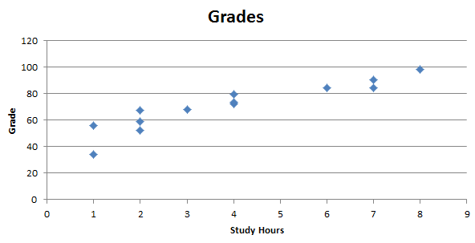
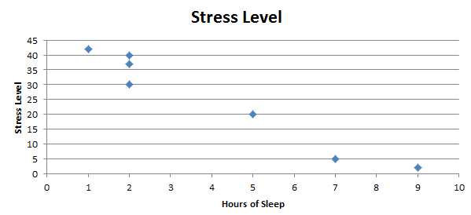
Key Concept
Examples :
Studying Hours and Grades!
Sleep v. Stress Level.
We would like a numerical measurement of the strength of the relationship between two variables representing quantitative data.
sample linear correlation coefficient: r

Slide 3
Exploring the Data
We can often see a relationship between two variables by constructing a SCATTERPLOT.
Notes:
Relate a scatter plot to the algebraic plotting of number pairs (x,y).

Slide 4
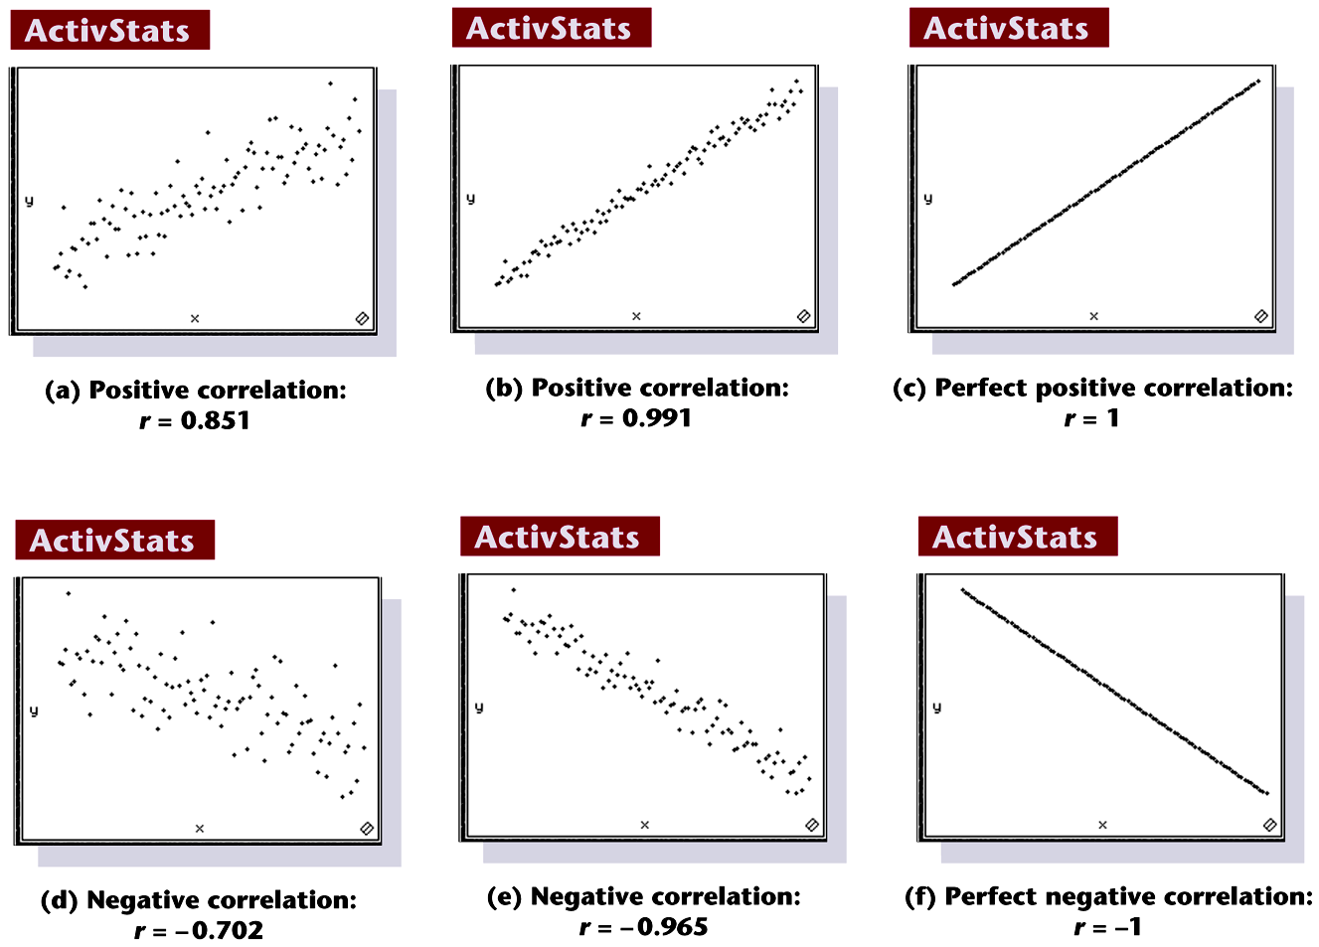
Scatterplots of Paired Data
Notes:
Page 619 of text

Slide 5
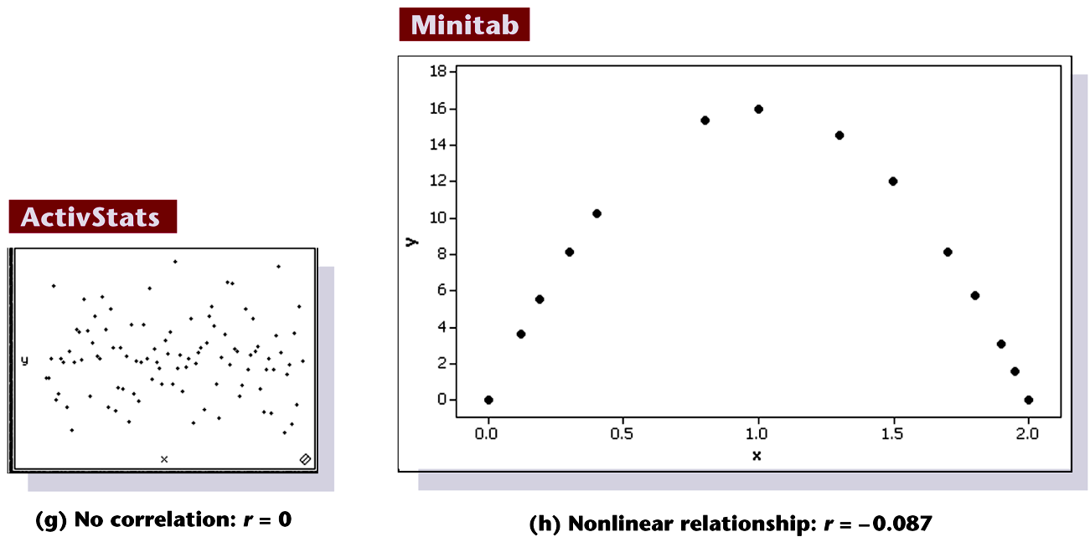
Scatterplots of Paired Data
Notes:
Page 619 of text

Slide 6
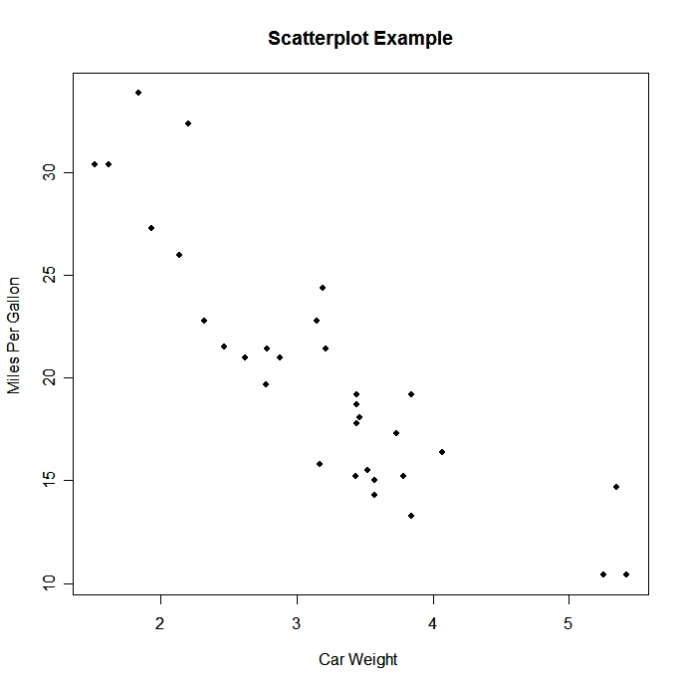

Which correlation coefficient best describes the scatter plot?
r = .32
r = 0
r = -1
r = -.78
r = -.1
r = .80

Slide 7
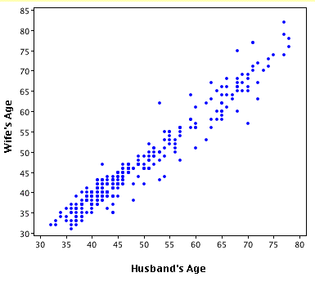
Which correlation coefficient best describes the scatter plot?
r = .32
r = -.89
r = 1
r = -.345
r = .95
r = -.5

Slide 8
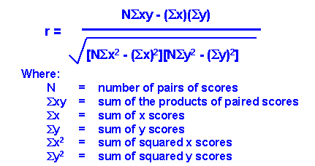
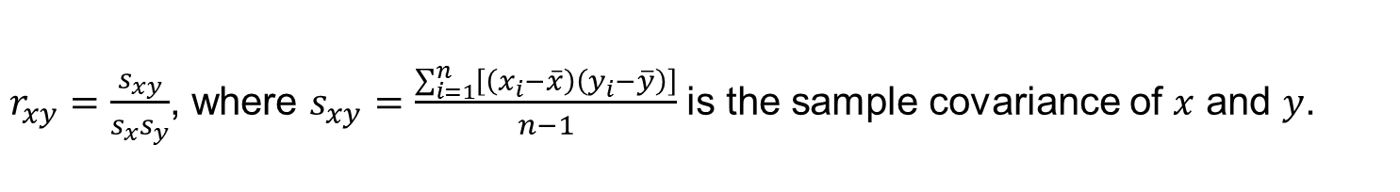
How do we find r?
$r_{xy}=\frac{s_{xy}}{s_{x}s_{y}}$, where $s_{xy}=\frac{\sum_{i=1}^{n}{\left[\left(x_{i}−\overline{x}\right)\left(y_{i}−\overline{y}\right)\right]}}{n−1}$ is the sample covariance of $x$ and $y$.

Slide 9
Properties of the Sample Linear Correlation Coefficient r
1. r measures strength of a linear relationship.
2. –1 ≤ r ≤ 1
3. The value of r does not change if the x and y variables (axes) are switched. (Try it with an example and with the formula!)
4. The value of r does not change if all values of either variable are converted linearly (new_x = a*old_x +b) to a different scale, i.e., not a nonlinear transformation like a log transformation. (Try it!)
Notes:
page 524 of text
If using a graphics calculator for demonstration, it will be an easy exercise to switch the x and y values to show that the value of r will not change.

Slide 10
Requirements
The paired (x, y) data is independent, quantitative data.
Visual examination of the scatterplot must confirm that the points approximate a straight-line pattern.
The outliers must be removed if they are known to be errors. The effects of any other outliers should be considered by calculating r with and without the outliers included.
The standard deviation of one variable should be equal across values of the other variable.
To generalize the results to a broader population, the sample should be randomly selected from the population.
In general, correlation does not imply causation. To imply causation, the subjects must be randomly assigned to different values of the independent variable. (Note that the values of the independent variable do not need to be random. For example, they could be equally spaced levels of a factor.)
Notes:
page 520 of text
Explain to students the difference between the ‘paired’ data of this chapter and the investigation of two groups of data in Chapter 9.

Slide 11
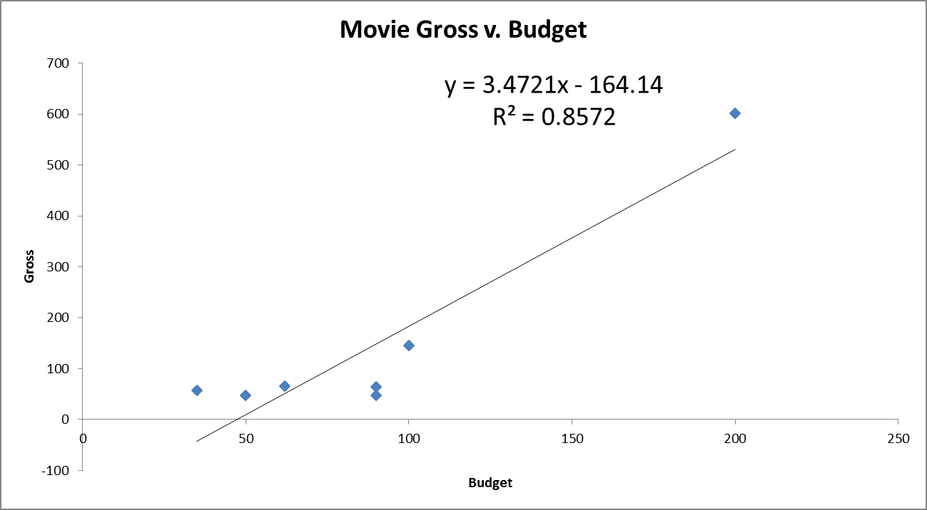
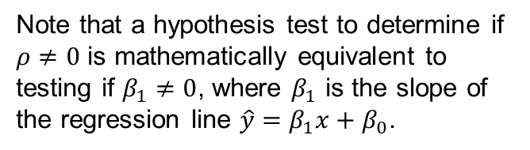
Correlation: Not resistant to outliers
$ρ$ is the population correlation that $r$ estimates.
Note that a hypothesis test to determine if $ρ≠0$ is mathematically equivalent to testing if $β_{1}≠0$, where $β_{1}$ is the slope of the regression line $\hat{y}=β_{1}x+β_{0}$.

Slide 12

Interpreting r² : Explained Variation
The metric r² is called the coefficient of determination.
The value of r² is the proportion of the variation in y that is explained by the linear relationship between x and y.
In ANOVA, $r^{2}=\frac{{SS}_{model} (top row)}{{SS}_{total} (bottom row)}$
Notes:
page 524 of text
If using a graphics calculator for demonstration, it will be an easy exercise to switch the x and y values to show that the value of r will not change.

Slide 13
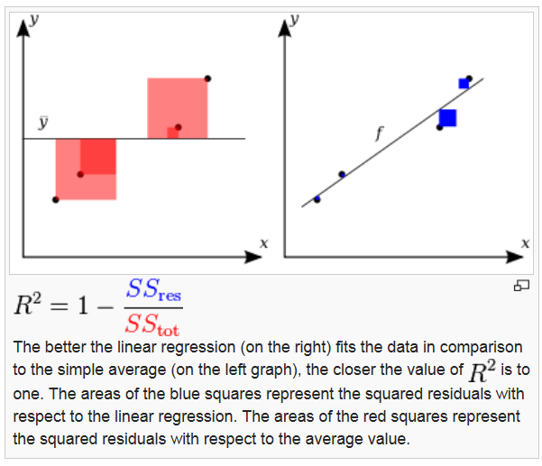
R²: comparing SS(straight line model) to SS(equal means model)

Slide 14
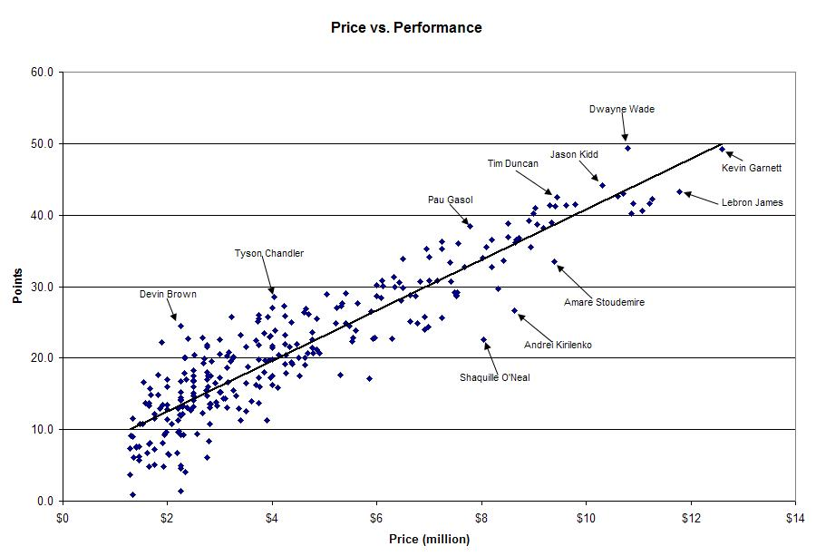
Do not confuse fewer data points with a smaller standard deviation.
r = .907
Price explains 82.3% of the variation in point production for NBA players in this year.
r² = 0. 823

Slide 15
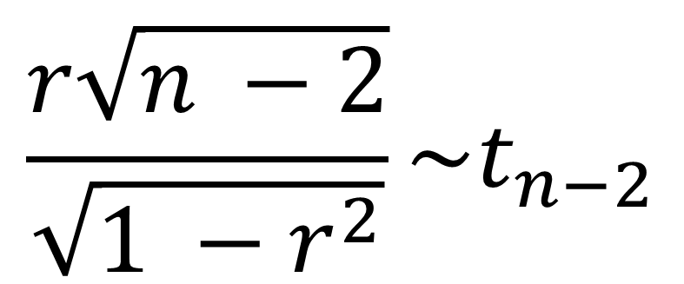
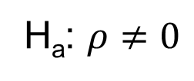
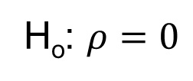
The Test Statistic!!!
$ρ$ is the population correlation that $r$ estimates.
H_{o}: $ρ=0$
H_{a}: $ρ≠0$
$$\frac{r\sqrt{n −2}}{\sqrt{1 −r^{2}}}\sim t_{n−2}$$

Slide 16
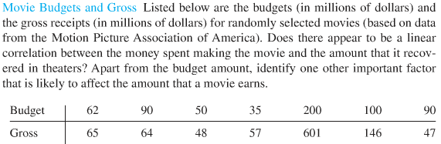
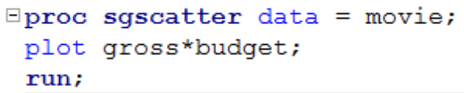
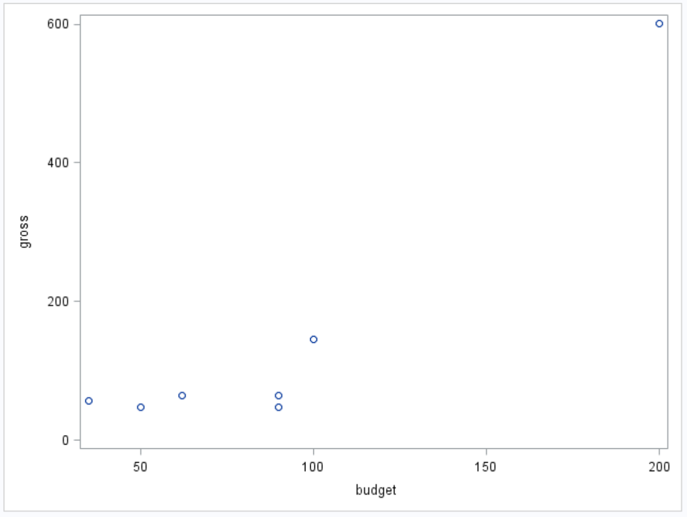
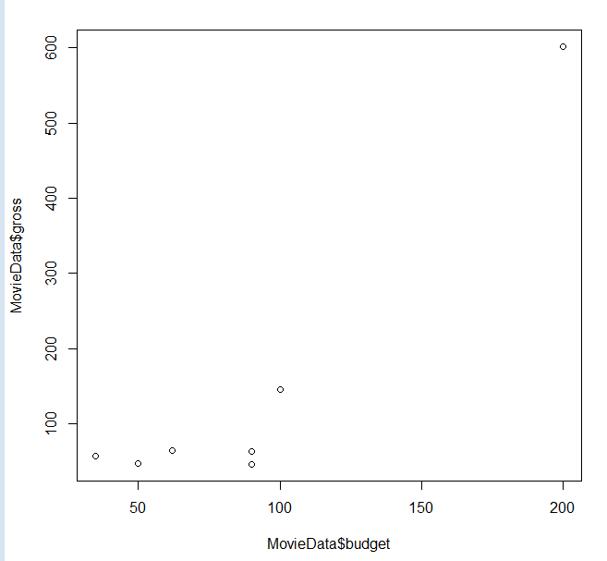
Movies!!!
Check the scatter plot to determine if a linear relationship is plausible.

Slide 17
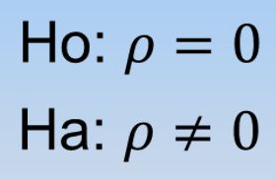
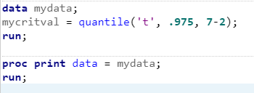

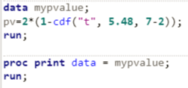


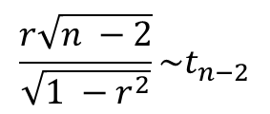
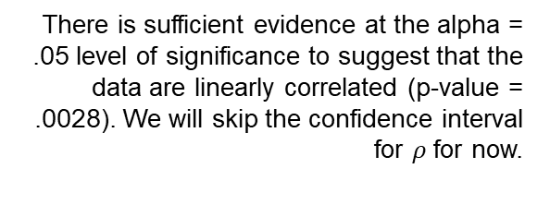
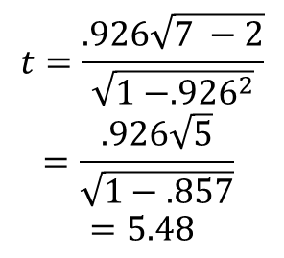
Movies!!!
$$\frac{r\sqrt{n −2}}{\sqrt{1 −r^{2}}}\sim t_{n−2}$$
There is sufficient evidence at the alpha = .05 level of significance to suggest that the data are linearly correlated (p-value = .0028). We will skip the confidence interval for $ρ$ for now.
Critical Value (use software)
$$±t_{.975, 7−2}=±2.57$$
Test statistic
It is estimated that r² = 85.7% of the variation in the Gross Sales is explained by the Movie Budget!
$$t=\frac{.926\sqrt{7 −2}}{\sqrt{1 −{.926}^{2}}}$$
$$=\frac{.926\sqrt{5}}{\sqrt{1−.857}}$$
$$=5.48$$
Because the data is randomly selected, the results can be generalized to the entire population of movies associated with the MPAA. Because the budgets were not randomly assigned, causality cannot be established, only association.
Other factors that affect gross sales may include the type of movie, the actors in the movie, etc.
P-value =.0028
(use software if the t-value is calculated “by hand”)
Reject H_{o}

Slide 18
Breakout!

Slide 19
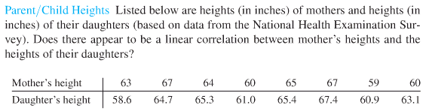
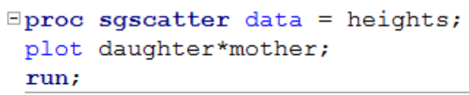
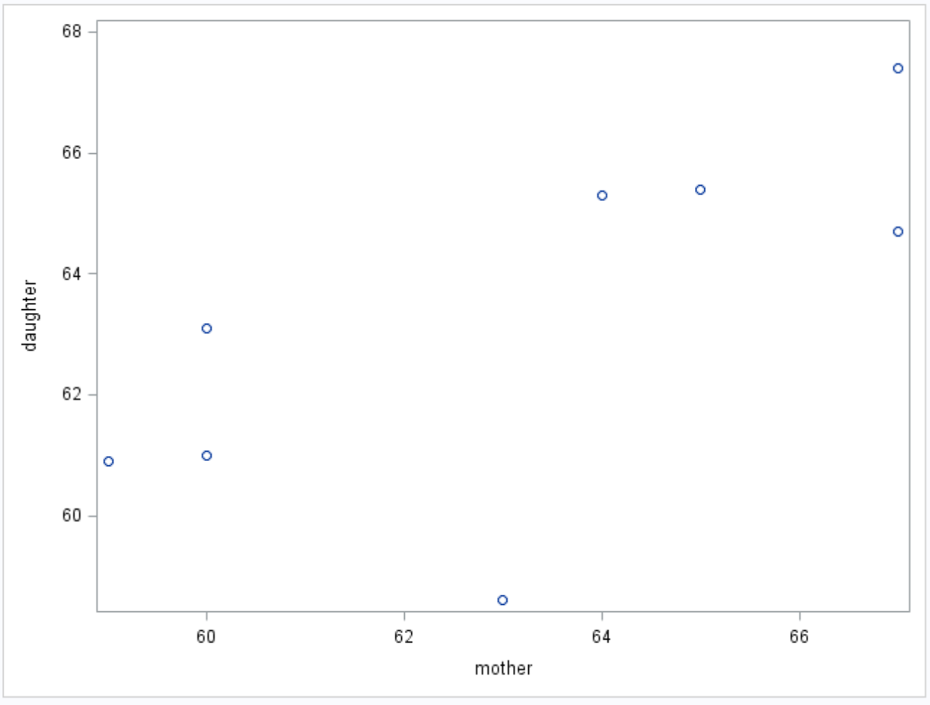
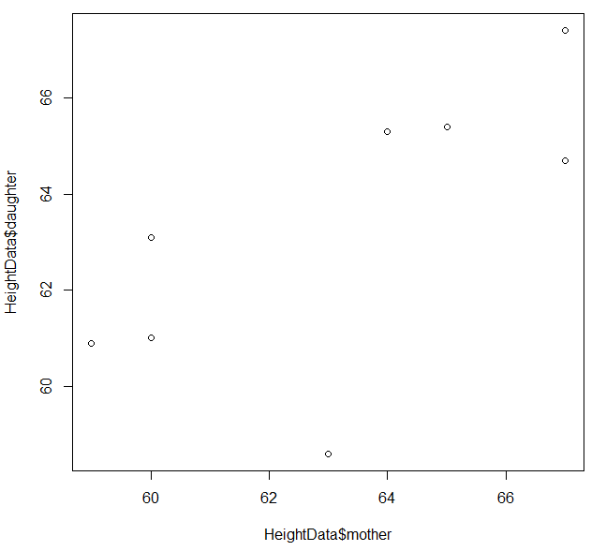
Mother/Daughter Heights
Check the scatter plot to determine if a linear relationship is plausible.

Slide 20


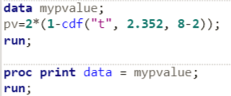
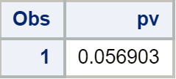
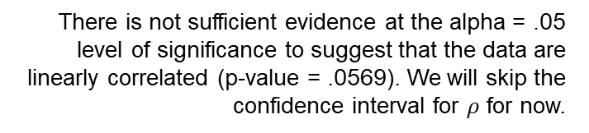

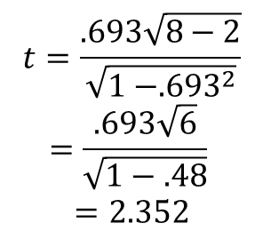
Mother/Daughter Heights
$$\frac{r\sqrt{n −2}}{\sqrt{1 −r^{2}}}\sim t_{n−2}$$
There is not sufficient evidence at the alpha = .05 level of significance to suggest that the data are linearly correlated (p-value = .0569). We will skip the confidence interval for $ρ$ for now.
Critical Value (use software)
$$±t_{.975, 8−2}=±2.45$$
Test statistic
It is estimated that r² = 48% of the variation in the Daughter height is explained by the Mother height!
$$t=\frac{.693\sqrt{8−2}}{\sqrt{1 −{.693}^{2}}}$$
$$=\frac{.693\sqrt{6}}{\sqrt{1−.48}}$$
$$=2.352$$
Because the we do not know much about how the data was sampled, the results cannot be generalized to the entire population of mothers and daughter in the NHES. Because the results are not significant, there is no need to discuss causality.
P-value =.0569
(use software if the t-value is calculated “by hand”)
Fail to Reject Ho (at alpha = 0.05)

Slide 21
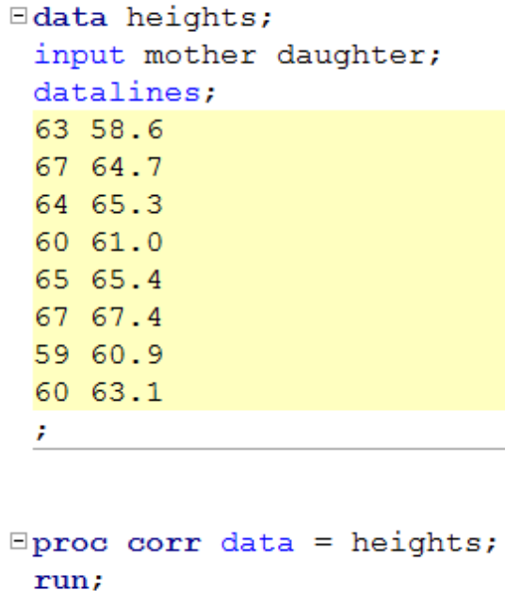
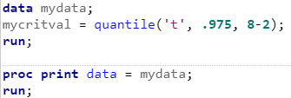
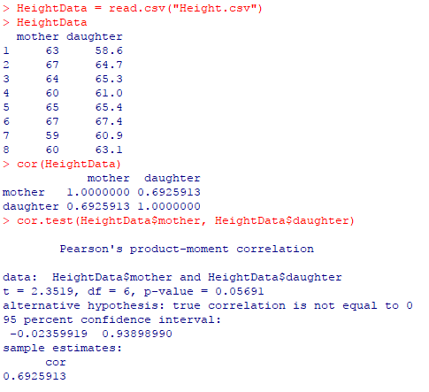


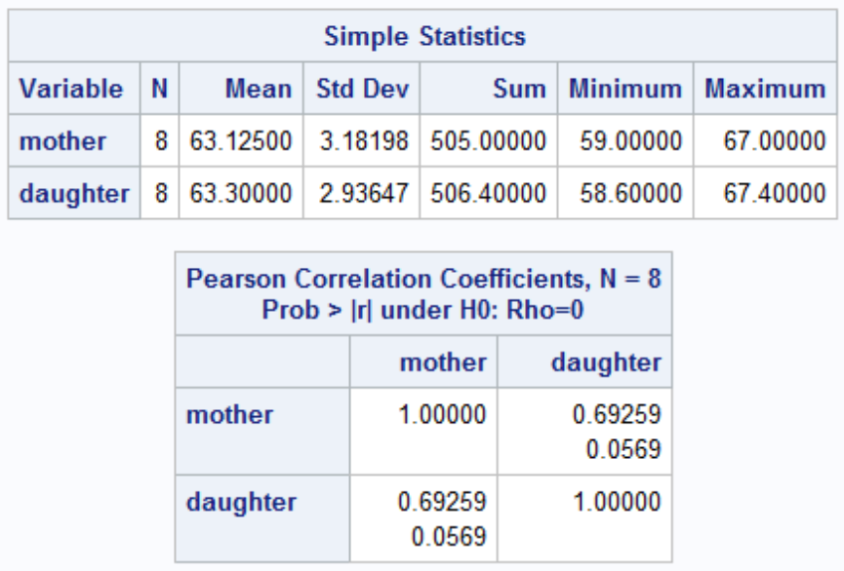
SAS and r: Parent Child Heights
P-value
Sample Correlation Coefficient r

Slide 22
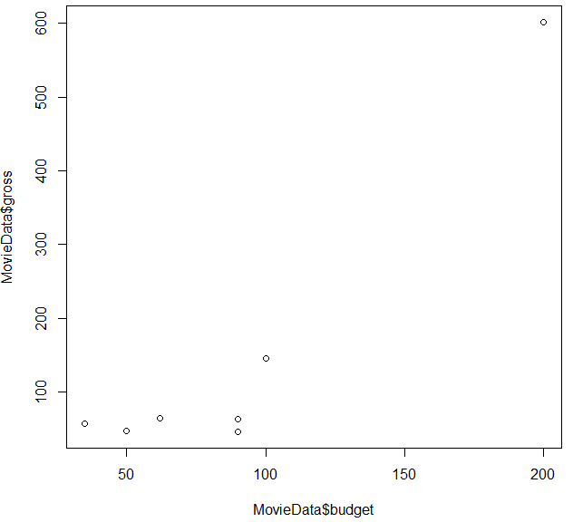
Back to Movies!!!
Check the scatter plot to determine if a linear relationship is plausible.

Slide 23
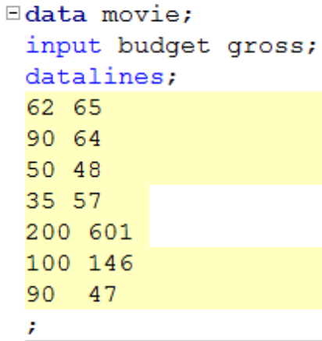
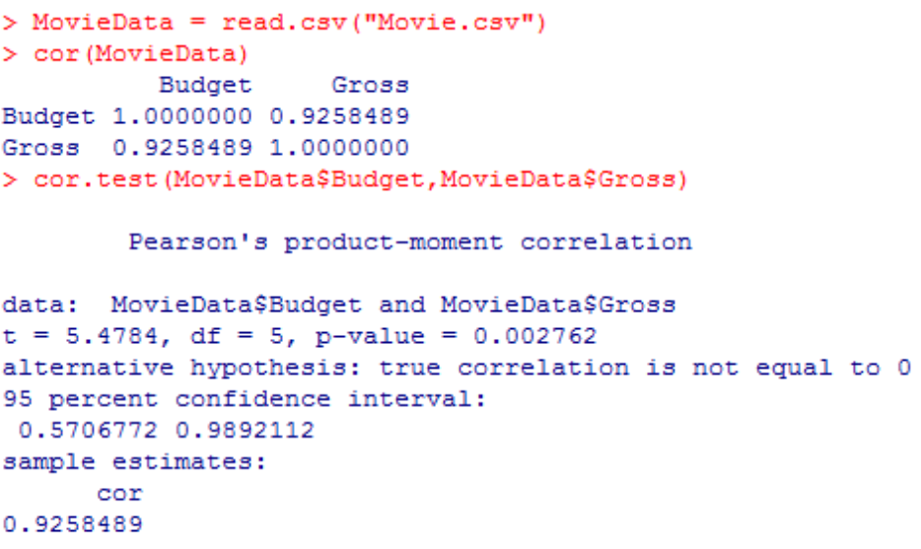


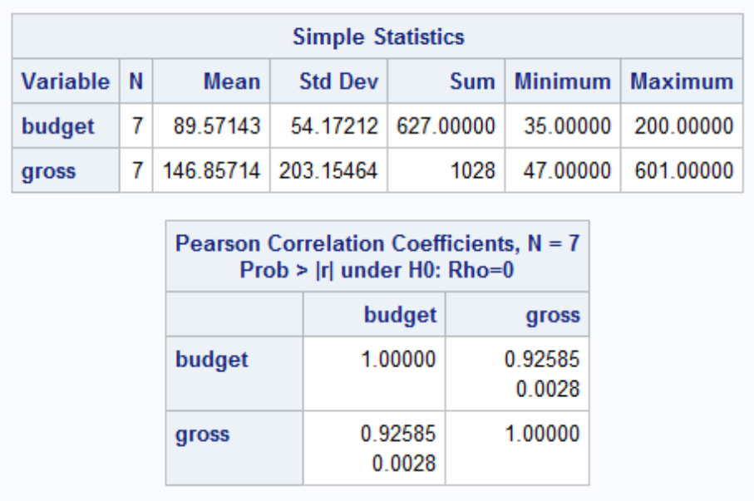
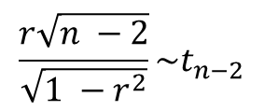
SAS and r: Movie Data
$$\frac{r\sqrt{n −2}}{\sqrt{1 −r^{2}}}\sim t_{n−2}$$
P-value
Sample Correlation Coefficient r

Slide 24
Breakout

Slide 25
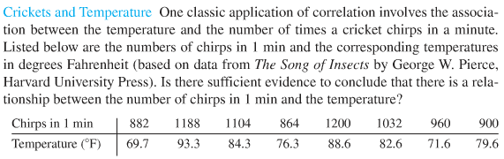
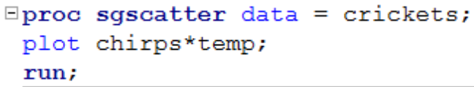
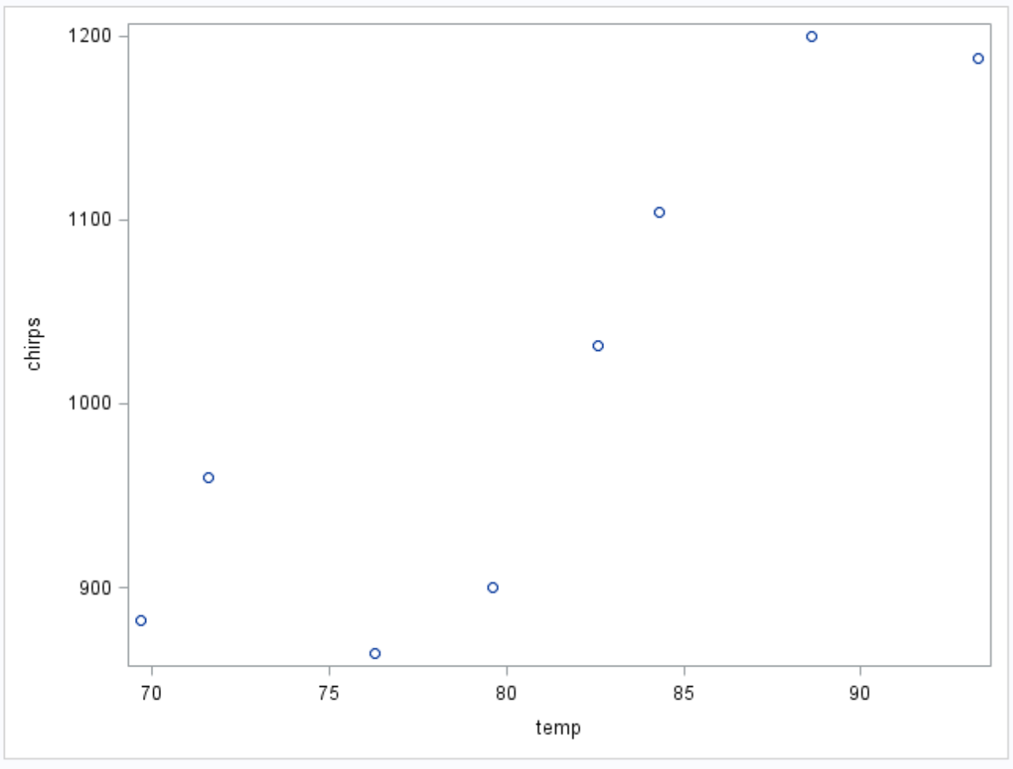
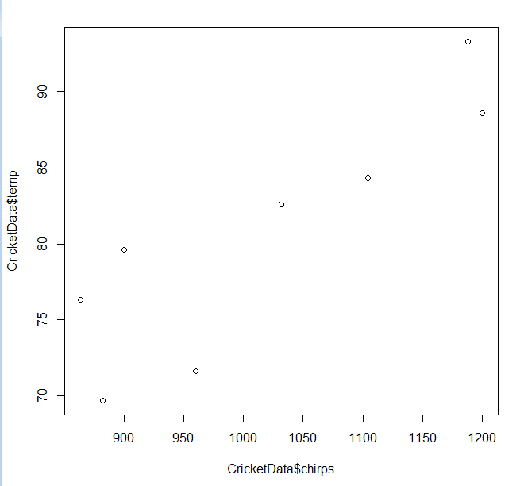
Crickets!!!
It might seem counterintuitive to predict temperature based on the number of chirps (versus the other way around), but that is the question of interest here!
Check the scatter plot to determine if a linear relationship is plausible.

Slide 26
Crickets!!!
$$\frac{r\sqrt{n −2}}{\sqrt{1 −r^{2}}}\sim t_{n−2}$$
Critical Value (use software)
$$±t_{.975, 8−2}=±2.45$$
Test statistic

Slide 27
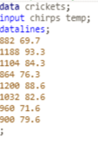
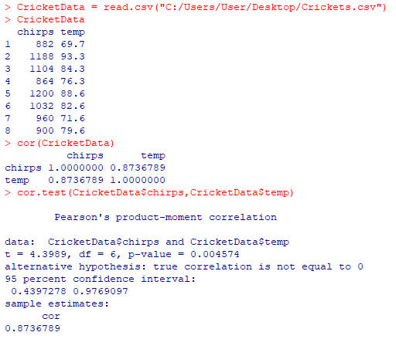

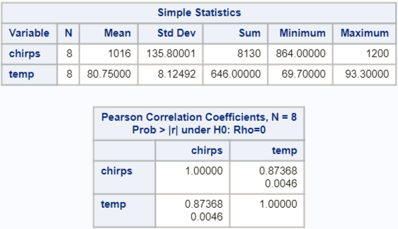

SAS and r: Cricket Data
$$\frac{r\sqrt{n −2}}{\sqrt{1 −r^{2}}}\sim t_{n−2}$$
Sample Correlation Coefficient r

Slide 28

Crickets!!!
$$\frac{r\sqrt{n −2}}{\sqrt{1 −r^{2}}}\sim t_{n−2}$$
Critical Value (use software)
$$±t_{.975, 8−2}=±2.45$$
Test statistic
$$t=\frac{.874\sqrt{8 −2}}{\sqrt{1 −{.874}^{2}}}$$
$$=\frac{.874\sqrt{6}}{\sqrt{1−.764}}$$
$$=4.40$$
P-value =

Slide 29
SAS and r: Cricket Data
$$\frac{r\sqrt{n −2}}{\sqrt{1 −r^{2}}}\sim t_{n−2}$$
P-value

Slide 30


Crickets!!!
$$\frac{r\sqrt{n −2}}{\sqrt{1 −r^{2}}}\sim t_{n−2}$$
There is sufficient evidence at the alpha = .05 level of significance to suggest that the data are linearly correlated (p-value = .0046). We will skip the confidence interval for $ρ$ for now.
Critical Value
$$±t_{.975, 8−2}=±2.45$$
Test statistic
It is estimated that r² = 76.4% of the variation in the Temperature is explained by the Chirps per Minute!
$$t=\frac{.874\sqrt{8 −2}}{\sqrt{1 −{.874}^{2}}}$$
$$=\frac{.874\sqrt{6}}{\sqrt{1−.764}}$$
$$=4.40$$
Because we do not know much about how the data was selected (at least within the scope of this PowerPoint), we cannot generalize the results beyond the data under study, though the results are interesting. Because the chirps per minute were not randomly assigned, causality cannot be established, only association.
P-value =.0046
Reject H_{o} (at level alpha = 0.05)

Slide 31




Marathons!!!
Check the scatter plot to determine if a linear relationship is plausible.

Slide 32
Marathons!!!
$$\frac{r\sqrt{n −2}}{\sqrt{1 −r^{2}}}\sim t_{n−2}$$
Critical Value (use software)
$$±t_{.975, 8−2}=±2.45$$
Test statistic

Slide 33




SAS and r: Marathon Data
$$\frac{r\sqrt{n −2}}{\sqrt{1 −r^{2}}}\sim t_{n−2}$$
Sample Correlation Coefficient r

Slide 34

Marathons!!!
$$\frac{r\sqrt{n −2}}{\sqrt{1 −r^{2}}}\sim t_{n−2}$$
Critical Value (use software)
$$±t_{.975, 8−2}=±2.45$$
Test statistic
$$t=\frac{.183\sqrt{8 −2}}{\sqrt{1 −{.183}^{2}}}$$
$$=\frac{.183\sqrt{6}}{\sqrt{1−.033}}$$
$$=.4563$$
P-value =

Slide 35
SAS and r: Marathon Data
$$\frac{r\sqrt{n −2}}{\sqrt{1 −r^{2}}}\sim t_{n−2}$$
P-value

Slide 36

Marathons!!!
There is not sufficient evidence at the alpha = .05 level of significance to suggest that the data are linearly correlated (p-value = .6642). We will skip the confidence interval for $ρ$ for now.
$$\frac{r\sqrt{n −2}}{\sqrt{1 −r^{2}}}\sim t_{n−2}$$
Critical Value (use software)
$$±t_{.975, 8−2}=±2.45$$
Test statistic
It is estimated that r² = 3.3% of the variation in the Winning Female Marathon Time is explained by the Temperature!
$$t=\frac{.183\sqrt{8 −2}}{\sqrt{1 −{.183}^{2}}}$$
$$=\frac{.183\sqrt{6}}{\sqrt{1−.033}}$$
$$=.4563$$
Because we do not know much about how the data was selected (at least within the scope of this PowerPoint), we cannot generalize the results beyond the data under study. Because no significant linear relationship is found, we cannot infer association between the variables, let alone causality.
P-value = 0.6642
Fail to Reject H_{o} (at level alpha = 0.05)

Slide 37
Appendix

Slide 38

We can use our Calcs!!!
STAT
TESTS
LinRegTTest
There’s our correlation coefficient!!!

